Slide 1



Acceptance Test Driven Development Bridging the gap between Business and Development
Yovka Pencheva, Concur Cloud Services

Slide 2
About Me
In Software Engineering for 15y
Programmer, Dev lead, SE lead, Test Automation lead, Test manager, Cloud Services Dev manager
Passionate about continuous delivery, continuous deployment, testing in production
Passionate about cycling and beer-ing

Slide 3
Agenda
Software Development Lifecycle (SDLC)
Waterfall, Communication Gap Between Business and Development, Agile
Agile Development
Test Driven Development (TDD)
Acceptance Test Driven Development (ATTD), Behavior Driven Development (BDD)
ATTD Frameworks (Cucumber), Hands on
Agile Testing Pyramid
Agile Testing Quadrant
ATTD Tests as living system Documentation

Slide 4
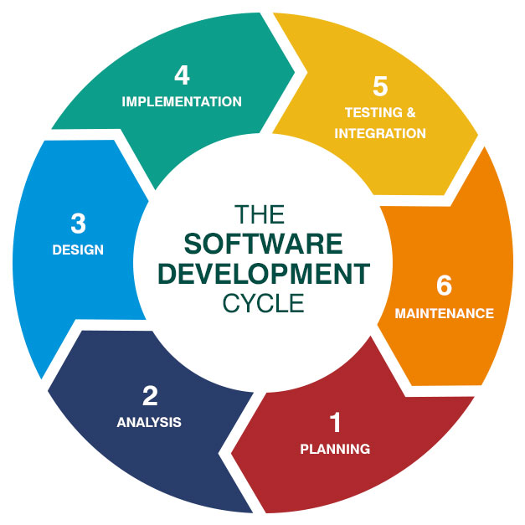
Software Development Lifecycle (SDLC)
Notes:
Planning -> Analysis -> Design -> Implementation (Coding) -> Testing and integration -> Release and maintenance

Slide 5
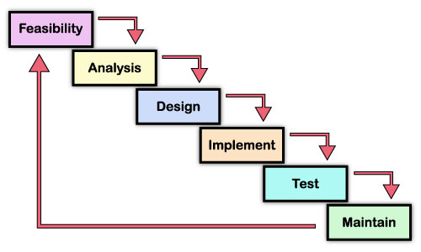
SDLC Waterfall
Heavy processes and paperwork
Sign-offs
Handovers
on each phase exit gate
Notes:
SDLC in Waterfall process was taking from 6 months to 3-4 years. No flexibility. Heavy processes and paperwork, sign-off, handovers on each phase gate.
Development/implementation much behind the business needs and changes. Customers feedback received months or years after customer requirements were gathered and defined. Customers/Business involved only in beginning and at the end of the lifecycle.
Proved to fail in rapid changing business conditions nowadays.

Slide 6
Communication Gap Between Business and Development
Notes:
Its very common to have communication gap between Business/Customers and Development. With Waterfall SDLC, it takes months or even years until this gap is discovered.

Slide 7
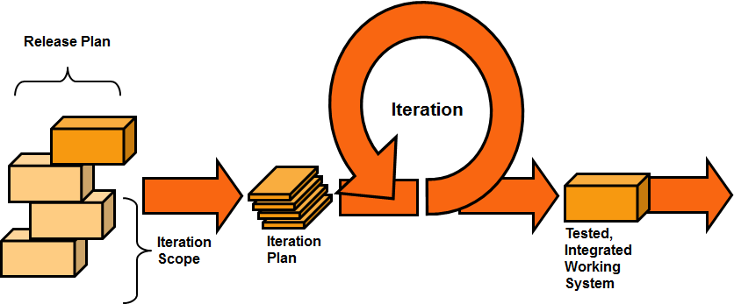
SDLC Agile
Notes:
With Agile Development process, SDLC moved within Agile iterations, short iterative SDLC cycles (2-4 weeks). Business deliverables (aka new software releases, new features) at the end of each SDLC iteration.
Frequent customer/business feedback. Agility and flexibility. Business/customers involved in process regularly.

Slide 8
Agile Development
Agile manifesto
Short SDLC iterations – plan, design, code, test, deploy and maintain
Whole team collaboration
Test and deploy features as they are coded
Customer/business people participation and involvement in each iteration
Deliver business value in each iteration
Inspect, adapt and adjust

Slide 9
Agile Development Practices Test Driven Development (TDD)
Test driven development (TDD). Unit testing.
first write an unit test, test fails in beginning
write code to implement the unit/function/method
run the test, test should pass
refactor, use tests as safety net
Extreme programming. Pair programming.
two engineers working on one workstation
code reviews and feedback

Slide 10
Behavior Driven Development (BDD) Acceptance Test Driven Development (ATTD)
Test driven development limitations
coding practice, business people/customers can not participate
developers define use cases and test cases
boundaries not clear, not business driven, can miss many edge cases
Behavior Driven Development
business behavior clarified up front, behavior used to drive development
human language used to define behavior
brings technology and business together
behavior driven development (BDD), acceptance driven development (ATTD), specification by example, executable specs → all mean the same

Slide 11
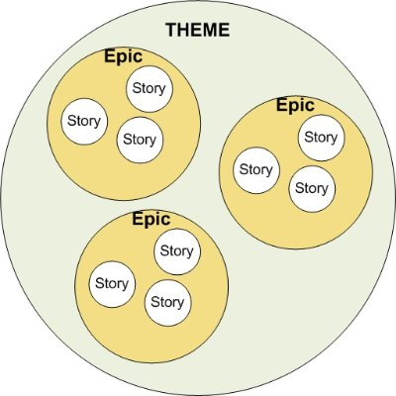
Agile Backlog Themes, Epics and Stories

Slide 12
Agile Story
User Story requires you to define every piece of requirement:
Who is the main stakeholder
What effect/functionality user wants from system with this requirement
Why, i.e. what business value would user get
As a user of the calculator program
I want to have an addition method in the program
So that I can add two numbers

Slide 13
Acceptance Criteria
User Story requires an acceptance criteria - conditions that a software product must satisfy to be accepted by a user, customer or other stakeholder
Gherkin syntax (GIVEN-WHEN-THEN) to define acceptance scenarios
GIVEN describes pre-requisites for scenario
WHEN describes actual steps of scenario
THEN describes verification that scenario requirements expectations are met
Given a calculator has an addition method
When I choose to add 2 numbers
And I add 2 and 2
Then the result is 4

Slide 14
ATTD/BDD Frameworks Cucumber
Cucumber is open source tool/framework for ATTD/BDD
Family of ATTD/BDD tools
Cucumber for Ruby
Cucumber-jvm, JBehave for Java
Cucumber.js for JavaScript
SpecFlow for .NET
Lettuce for Python
Single source of truth
Merge requirements specs and tests

Slide 15
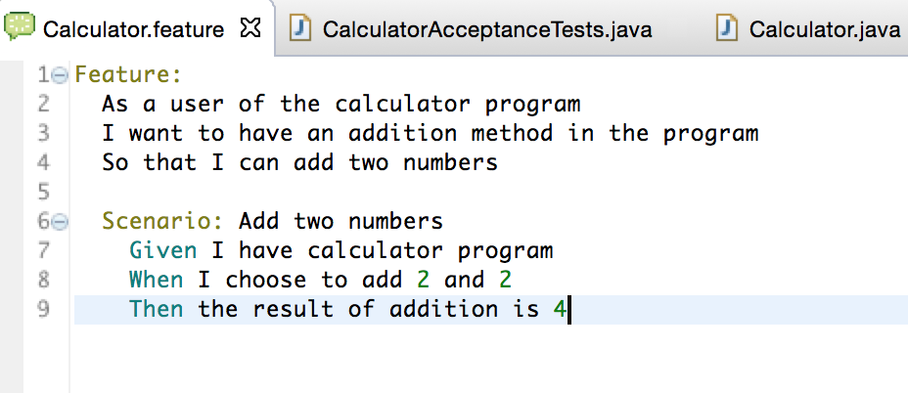
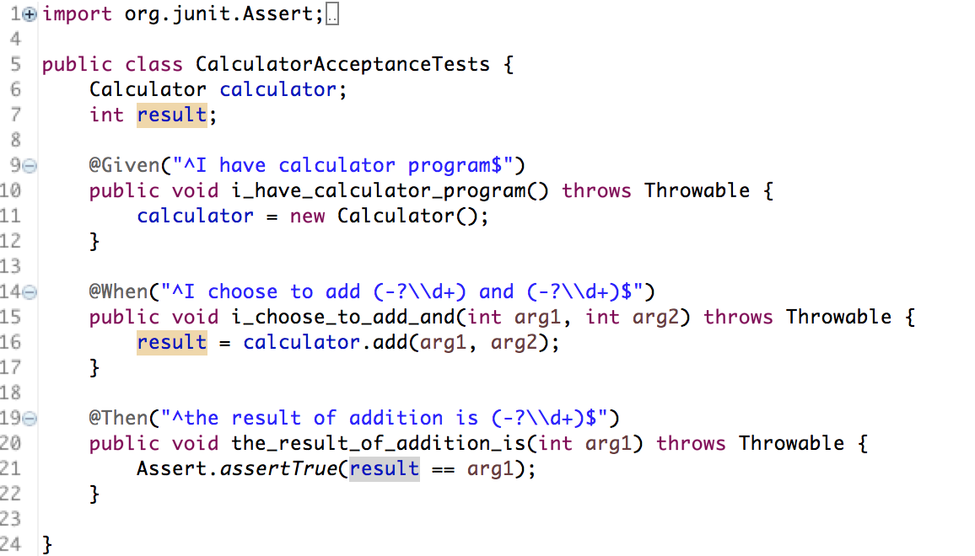
ATTD with Cucumber-JVM
Notes:
You execute and run .feature files!
With Cucumber-JVM plugin you can create the skeleton/glue code for step definitions.

Slide 16
Agile Testing Quadrant
Notes:
Remember – not EVERYTHNG should be automated, tests like exploratory tests, usability tests, localization tests, etc should not be tested.
A good approach for these tests is to do whole-team bug bash once per week and cover quickly these tests.

Slide 17
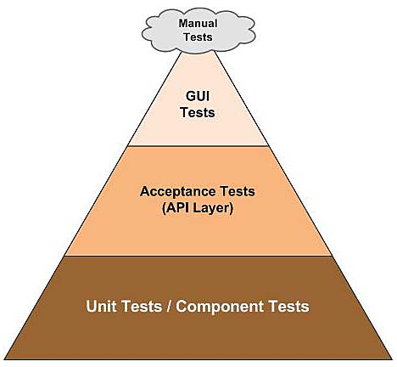
Agile Testing Pyramid
Test/automate at feature/scenario level (ATTD)
Test/automate at story level (ATTD)
Test/automate at task level (TDD)
Notes:
Unit tests – test and cover only small unit of program, typically a class or method. Written in same programming language like software. Written by developers. Test only small part of code, all interactions with other software/services (i.e. database connections or web services) are mocked. Extremely fast and reliable. This is the place where you aim for code path coverage.
Integration / API tests – test and verify interfaces and integrations between different components/services in a system, here we already have network connections, database connections, etc. Still reliable and fast, but not as much as unit tests.
UI / end-to-end tests – test the system end-to-end, most flaky and time consuming tests. This layer is most attempting for testers as this is what customers/users see and use, but at same time this is most unreliable and time consuming layer, so we should have fewer end-to-end tests on high level scenario levels, and test all boundaries, negative paths, etc on lower levels.

Slide 18
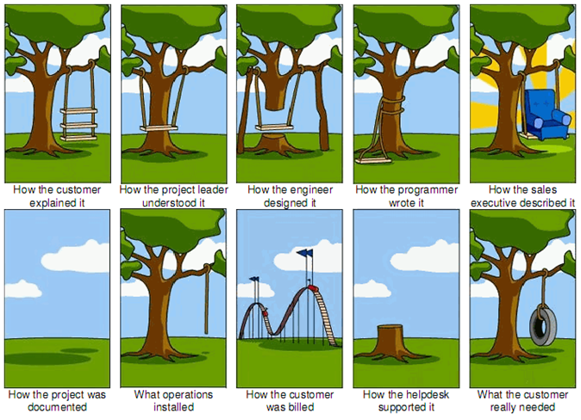
Where is Documentation?

Slide 19
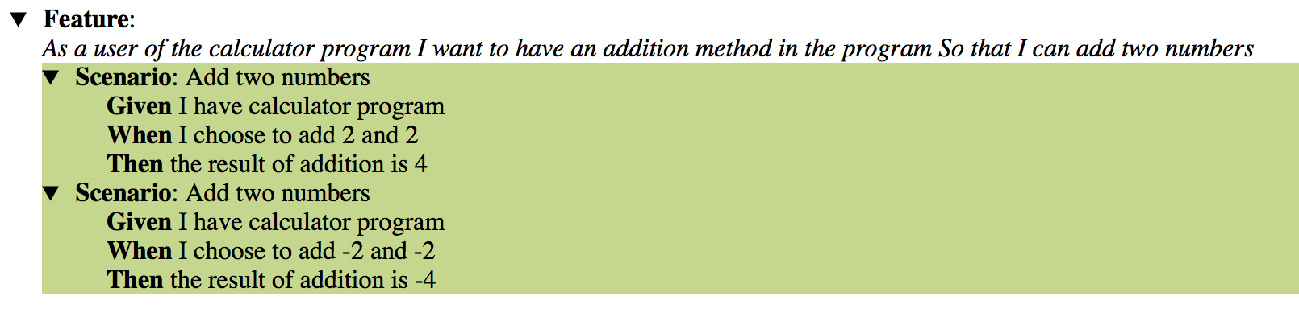
ATTD Tests as Documentation
Living system documentation, only guaranteed documentation to be up to date
As long as tests run GREEN

Slide 20
References
Agile Manifesto
Agile Testing
Specification by Example
Software testing levels and testing types
Cucumber
https://github.com/ypencheva/czechitas

Slide 21
Thank You!
Email: Yovka.Pencheva@concur.com
LinkedIn: www.linkedin.com/in/ypencheva

